Slide 1
AURA-Twin
Automated Understanding & Real-time Analysis Twin
Prepared by
Rawan Suliman Raghad Shaaban
Supervised by
Dr.Kadan Aljouma
Eng.Zeinab Baghdadi
Eng.Wesam Alsouhli

Slide 2
Baseline Phase: Binary Engine Anomaly Detection (FordA)
Dataset & Scope
Utilized the benchmark FordA dataset for binary engine health monitoring, categorizing operations into Normal vs. Faulty/Anomaly based on 1D raw acoustic/vibration signals (500 time-steps per sample(
Model Architecture
Implemented a Hybrid 1D-CNN + LSTM deep learning architecture, combining 1D-CNN layers for local spatial/frequency feature extraction with LSTM layers to capture long-term temporal dependencies in vibration dynamics.
Results
High diagnostic accuracy—exceeding 95%—was achieved in test partitions using robust sequence learning.

Slide 3
Problem Statement & Scientific Challenges
Manual Feature Extraction Inefficiency:
Traditional signal methods (FFT/Wavelet) demand complex manual tuning and often miss early, non-linear degradation signatures.
Severe Industrial Noise Contamination:
Harsh mechanical interference and ambient noise heavily degrade the diagnostic accuracy of shallow learning models
Limitations of Binary Classification:
Binary outputs (Normal vs. Faulty) cannot identify the specific damaged component nor quantify defect severity levels.

Slide 4
Objectives
  Zero-Downtime Reliability: Transitioning from reactive failure repairs to proactive, real-time health prognosis to eliminate sudden mechanical breakdowns and cut maintenance costs.
  Precision Degradation Tracking: Delivering early, sub-millimeter wear detection to accurately schedule component replacements before catastrophic failure occurs.
  Autonomous Diagnostics: Creating a self-contained intelligence pipeline that operates on raw operational data without requiring specialized human intervention.

Slide 5
Proposed Solution
Building an end-to-end diagnostic system that ingests raw vibration signals, segments them using overlapping time windows (2,048 samples), and feeds them into a 1D Deep Convolutional Neural Network with a wide first-layer kernel to automatically suppress noise, extract fault signatures, and classify them across 10 distinct categories with real-time accuracy.

Slide 6
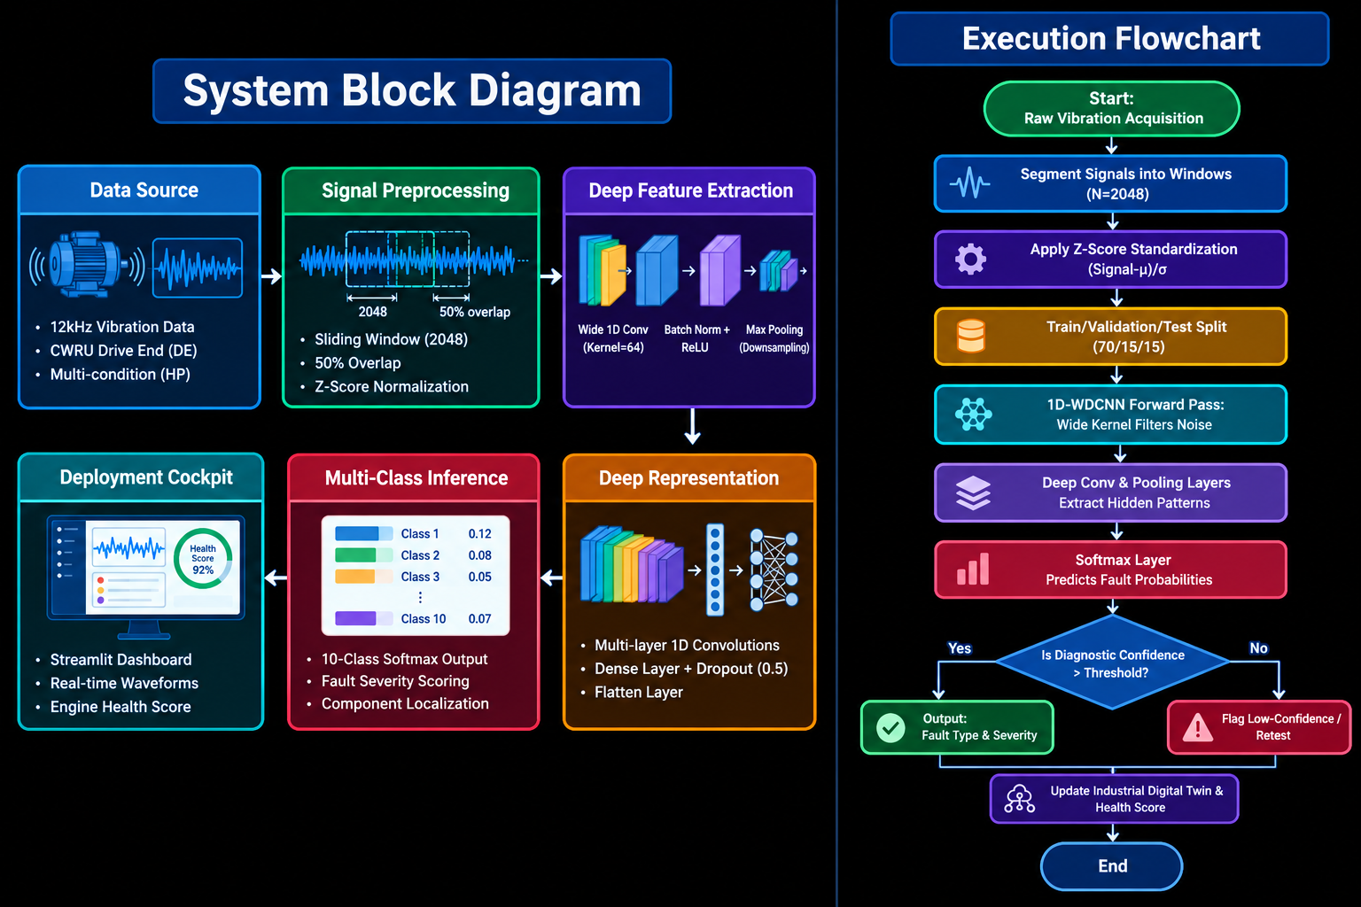
System Block Diagram

Slide 7
Execution Flowchart

Slide 8
Contents of this template
Paper Title | Year | Dataset Used | Training Approach | AI Model | Feature Extraction | Evaluation& Results
Vibration-based condition monitoring and fault diagnosis of rotating machinery: Fundamentals, signal processing techniques, standards, and emerging trends. | 2026 | Comprehensive Review Article; synthesizes data and findings from 238 peer-reviewed publications and international standards (e.g., ISO 10816, API 670). | Reviews Supervised Learning, Transfer Learning, Domain Adaptation, Unsupervised/Self-Supervised Learning, and Physics-Informed Hybrid Modeling | Covers Traditional Machine Learning (SVM, Random Forest), Deep Learning (1D-CNN, LSTM, Autoencoders), and Explainable AI (XAI). | Time-domain (RMS, Kurtosis), Frequency-domain (FFT), Time-frequency domain (STFT, Wavelets), and adaptive signal decomposition (VMD, EMD, Envelope Analysis). | Demonstrates superior diagnostic accuracy using adaptive decomposition and hybrid deep networks for non-stationary signals. Highlights Digital Twins, Physics-Informed AI, and Edge AI as key future directions for predictive maintenance.

Slide 9
Contents of this template
Paper Title | Year | Dataset Used | Training Approach | AI Model | Feature Extraction | Evaluation& Results
Bearing Fault Diagnosis Using CNN-LSTM Hybrid Model For Predictive Maintenance | 2026 | Case Western Reserve University (CWRU) Bearing Dataset (incorporating Drive End (DE) and Fan End (FE) vibration signals). | Data Split: Stratified split of 70% training, 15% validation, and 15% testing. Data Augmentation: Gaussian noise injection, random amplitude scaling, and random time-shifting. Optimization: Adam optimizer with Categorical Cross-Entropy loss over 20 epochs. | Dual-branch Hybrid CNN-LSTM Architecture: Time-domain branch: Conv1D layers followed by an LSTM layer (64 units). Frequency-domain branch: STFT spectrogram conversion followed by Conv2D layers. Feature fusion via Dense layers and classification with a Softmax output layer. | Automated End-to-End Feature Extraction combining Time-Domain raw vibration signals and Time-Frequency representations (STFT) without hand-crafted features. | Accuracy: 96.00% (Training accuracy reached ~97%) Precision: 95.00% Recall: 94.00% F1-Score: 95.00% Comparative Performance: Outperformed KNN (71.34%), Decision Tree (95.69%), and ResNet-50 + SVM (95.51%).

Slide 10
Contents of this template
Paper Title | Year | Dataset Used | Training Approach | AI Model | Feature Extraction | Evaluation& Results
Predictive Maintenance Using Machine Learning for Engineering Systems Through Real-Time Sensor Data and Anomaly Detection Models | 2026 | The paper is a broad framework review and does not introduce a single primary dataset. However, it references standard time-series sensor data from IIoT environments (vibration, temperature, pressure, acoustics, current) used in various benchmark case studies (e.g., CNC machines, jet engines, wind turbines). | The paper surveys multiple paradigms: Supervised Learning (for labeled historical fault data), Unsupervised Learning (for unlabeled anomaly detection), Semi-Supervised/Self-Supervised (Autoencoders), Hybrid/Ensemble Learning, and Federated Learning. . | Supervised: Random Forest, XGBoost, SVM, Logistic Regression, KNN. Unsupervised/Anomaly Detection: Isolation Forest, K-Means, PCA. Deep Learning: Autoencoders, 1D CNN, LSTM, GRU, Hybrid CNN-LSTM. | Time-domain features (RMS, Kurtosis, Crest Factor), Frequency-domain features (Fast Fourier Transform - FFT), Spectral Entropy, and End-to-End automatic feature learning using 1D CNNs and LSTMs. | Discusses evaluation metrics such as Accuracy, F1-Score, AUC-ROC (for classification/anomaly detection) and RMSE (for Remaining Useful Life - RUL estimation). Summarizes that hybrid/deep models achieve high F1-scores and low false-positive rates across manufacturing, rail, aviation, and energy deployments.

Slide 11
Contents of this template
Paper Title | Year | Dataset Used | Training Approach | AI Model | Feature Extraction | Evaluation& Results
Trustworthy bearing fault diagnosis based on evidential deep learning and quadratic convolution neural network | 2026 | CWRU dataset (12 kHz drive-end bearing, 10 fault classes) contaminated with Gaussian white noise at 0 dB and -6 dB | Evidential Deep Learning (EDL) via Dirichlet distribution; improved loss function combining relaxed evidential loss, Fisher Information Matrix penalty, and KL divergence regularization; trained via SGD and ReLinear strategy | EQCNN (Evidential Quadratic Convolutional Neural Network built on Wide Deep CNN architecture) | Wide quadratic convolutional kernel (64 \times 1 \times 16) in Layer 1, embedded attention mechanism (Qttention), BN, ReLU, and Max Pooling across 6 QConv blocks | - Accuracy: 97.53%–99.91% at -6 dB SNR across motor loads, and 100% at 0 dB[ - Uncertainty Quantification: Over 80% uncertainty for misclassifications and under 40% for correct predictions.Interpretability: Qttention maps accurately locate fault impact pulses

Slide 12
Contents of this template
Paper Title | Year | Dataset Used | Training Approach | AI Model | Feature Extraction | Evaluation& Results
Interpretable and Noise-Robust Bearing Fault Diagnosis for CNC Machine Tools via Adaptive Shapelet-Based Deep Learning Model | 2026 | CWRU (10 classes) and IMS run-to-failure datasets (4 classes) with Gaussian, Uniform, and Impulse noise (-6 dB to +8 dB) | Composite loss function (L_{CE} + \lambda_1 L_{cont} + \lambda_2 L_{cons}) combining cross-entropy, supervised contrastive loss (\lambda_1=0.05), and multi-scale consistency regularization (\lambda_2=0.02) with K-means++ initialization | Adaptive Shapelet-based CNN-BiLSTM | Multi-scale shapelets (lengths 16–256) with correlation-based distance, Gated parallel CNN (kernels 3, 5, 7), and Residual-enhanced BiLSTM | Accuracy: 87.67% (Gaussian), 85.65% (Uniform), and 82.33% (Impulse) at -6 dB on CWRU; 99.58% on IMS (clean) Superiority: Statistically significant improvement (p < 0.01) over standard baselines .Interpretability: FFT spectrum aligns with theoretical fault frequencies (e.g., BPFO = 107.4 Hz)

